Slide 1
Project Review
CS 347 - fall 2015
Nov 24th 2015

Slide 2
GROUP F: F15.f4
Patrizio Chiquini
Keith Wong
Justin Tran

Slide 3
PART I

Slide 4

GITHUB Repository
GitHub Link
https://github.com/Justin-Tran/F15F4-RFE-Project

Slide 5
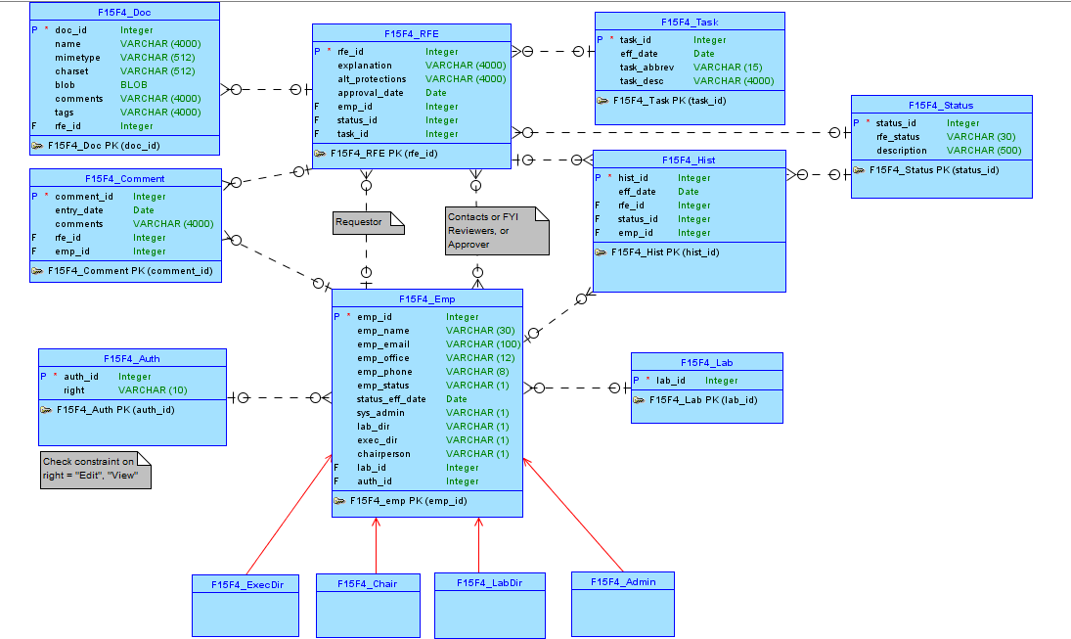
Conceptual Data Model

Slide 6
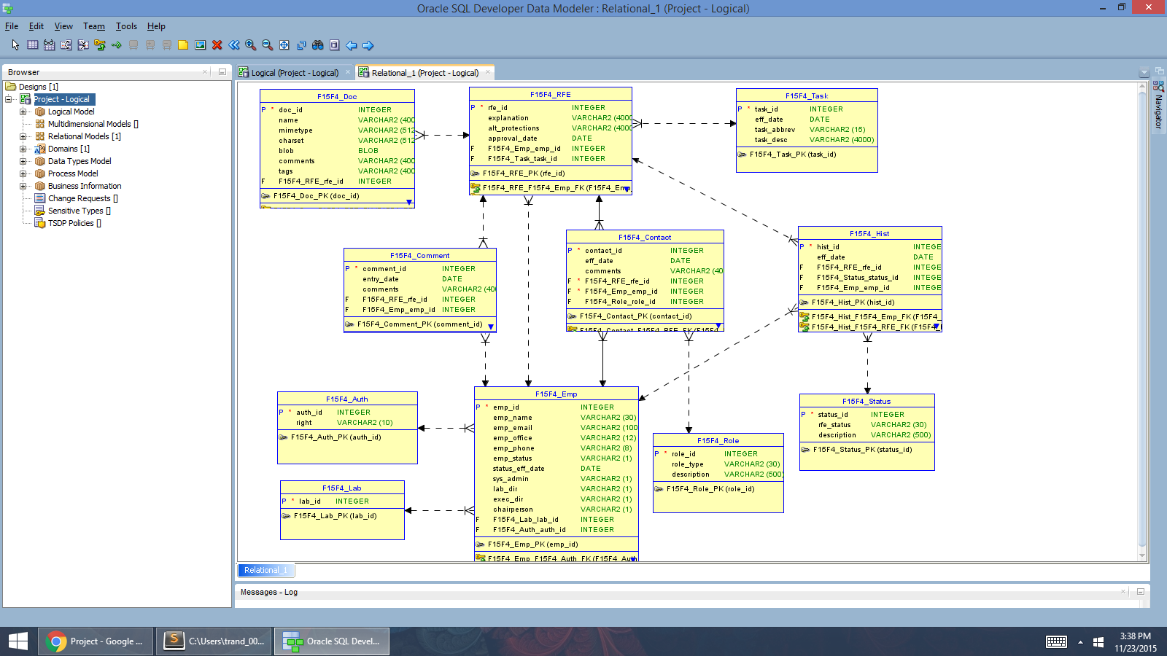
RELATIONAL Data Model

Slide 7
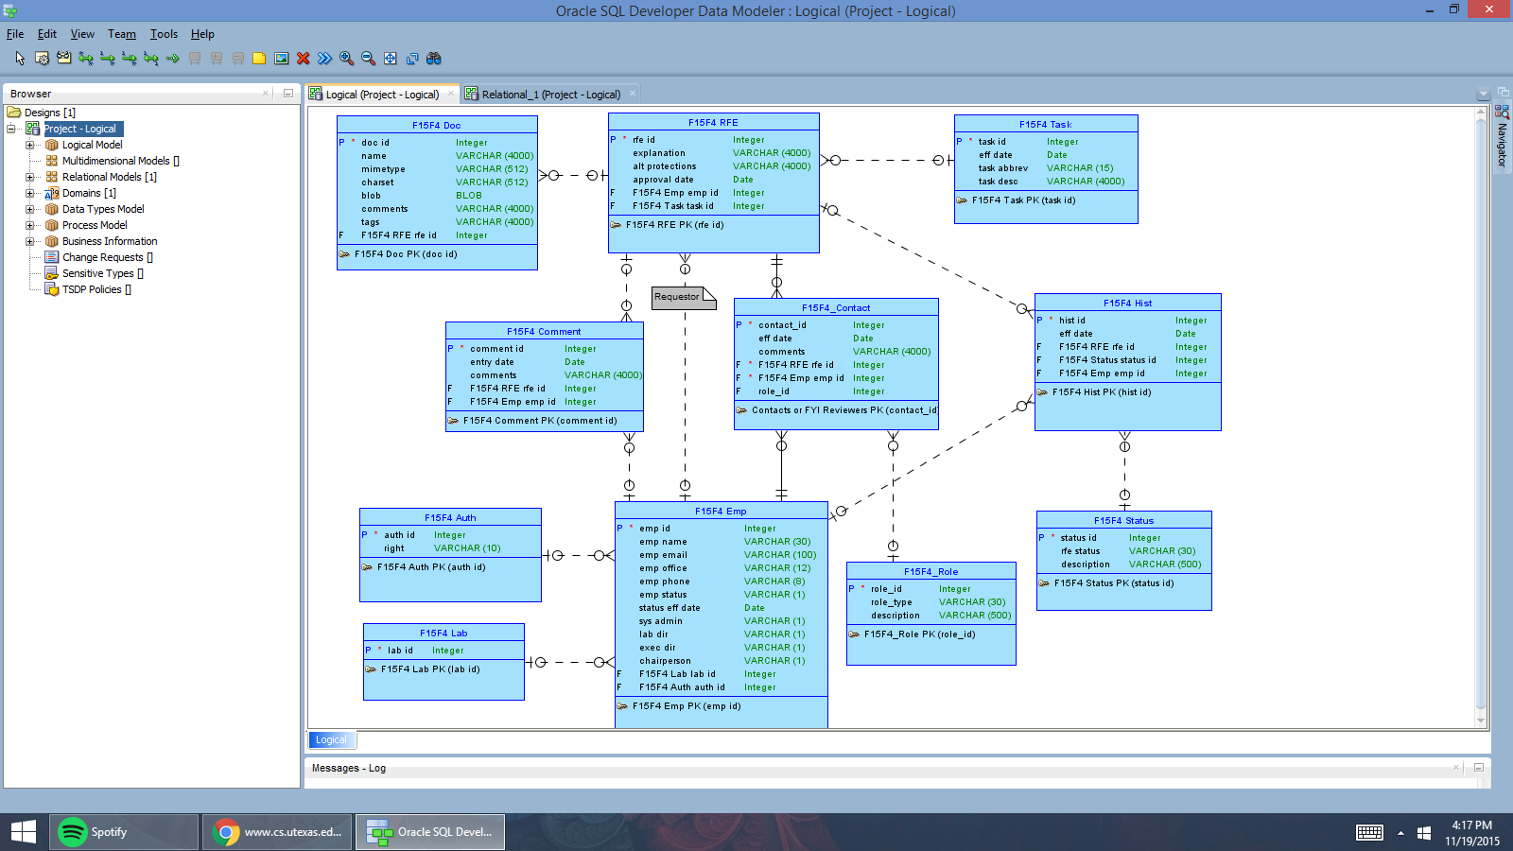
LOGICAL Data Model

Slide 8

prototype (DESKTOP) Apex Application
Desktop Apex URL:
https://apex.oracle.com/pls/apex/f?p=26577:1:105152665390464:::::
Notes:
https://apex.oracle.com/pls/apex/f?p=12434:1:6416007017000::NO:::

Slide 9
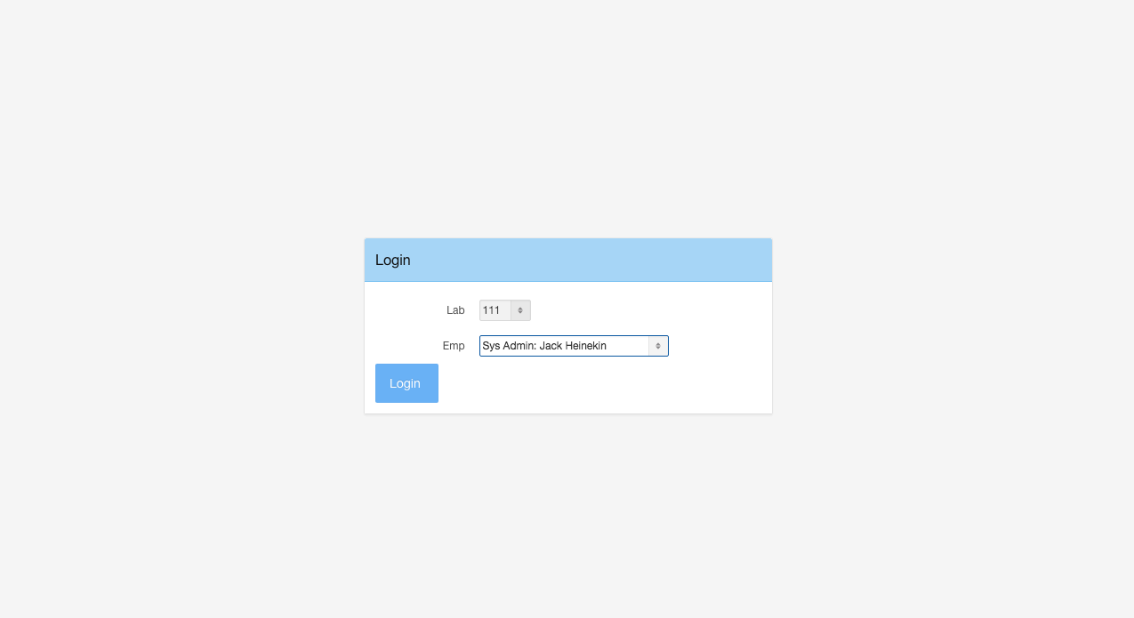
-> Login Page <-

Slide 10
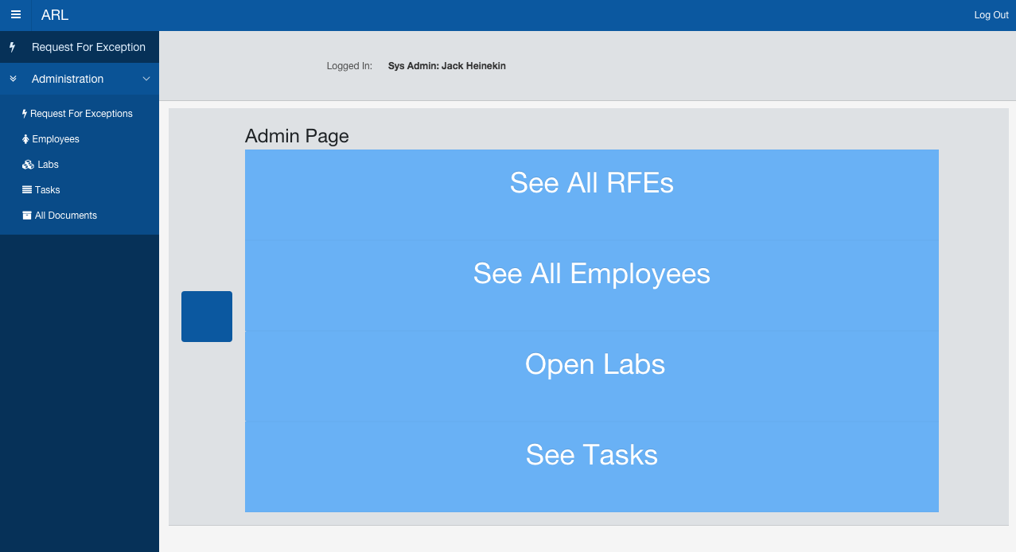
-> Special Right <-

Slide 11
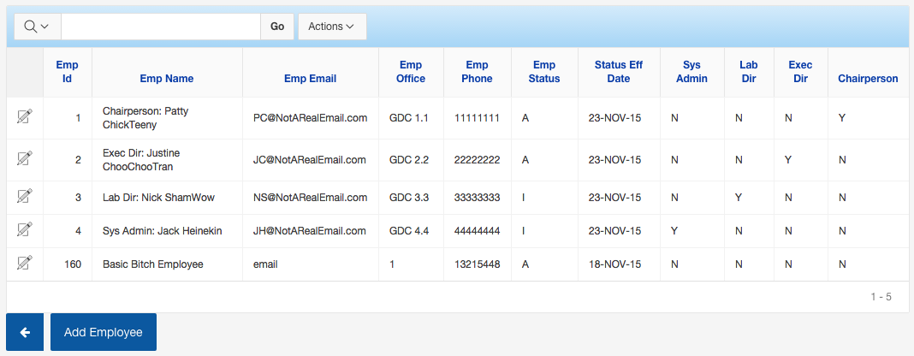
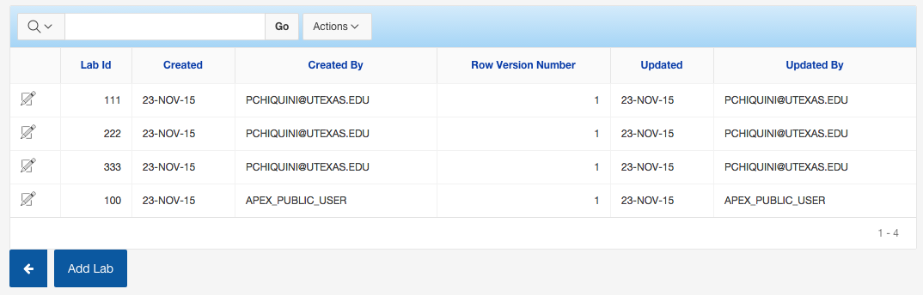
-> Add An Employee <-
-> Add A Lab <-

Slide 12
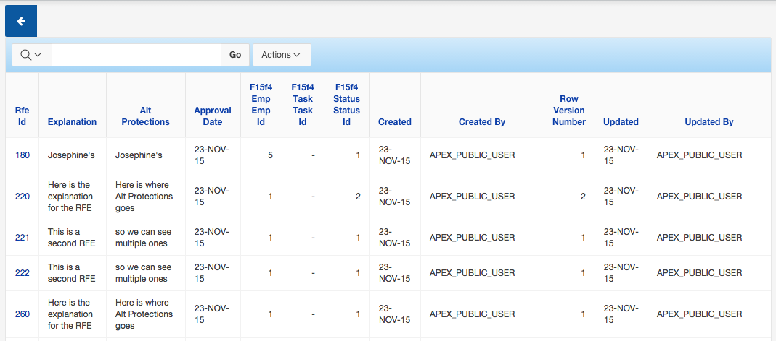
-> Add A RFE <-
But how can one manage the RFEs….

Slide 13
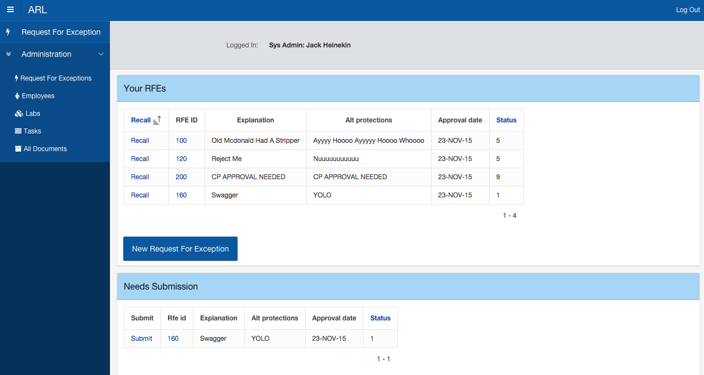
User’s Account ->
<- User’s RFEs
<- RFE needing Submssion

Slide 14
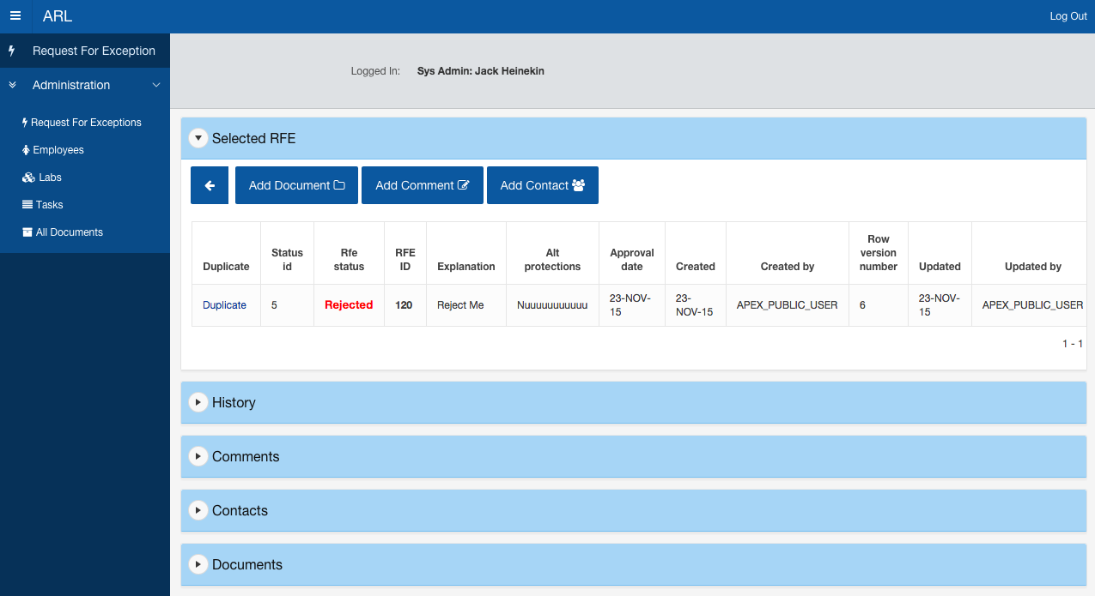
More Details About RFE

Slide 15
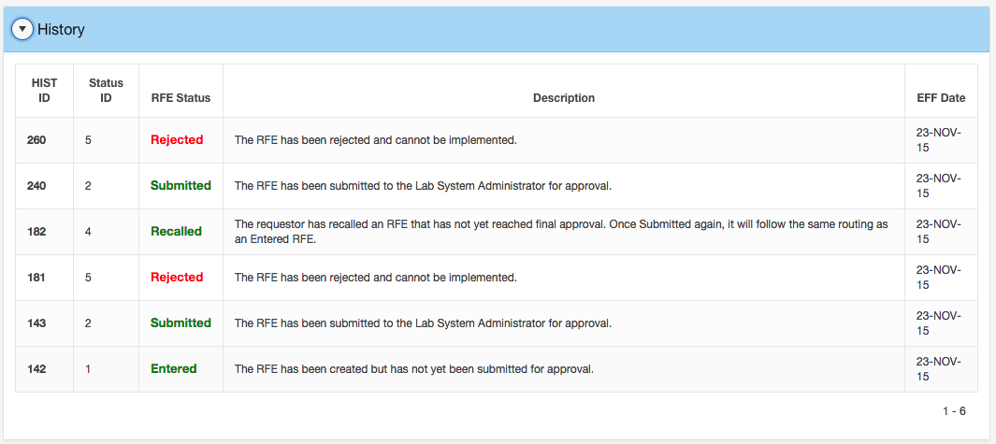
View RFE’s Status

Slide 16
Let’s Try it out

Slide 17
PART II

Slide 18
APP Apex
This simple app is meant for any Pokemon trainer out there.
It is an interactive application that allows you to navigate through different tabs for needed information.
It will categorized all the different Gym Locations, Gym Leaders, and their Pokemons so you can be ready to face them

Slide 19

MOBILE Apex Application
Mobile Apex URL:
https://apex.oracle.com/pls/apex/f?p=35489:1:2299735944791:::::
Notes:
https://apex.oracle.com/pls/apex/f?p=93045:1:115831188601227::NO:::

Slide 20
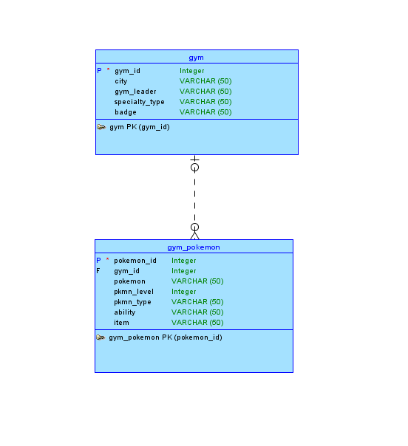
Conceptual Data Model

Slide 21
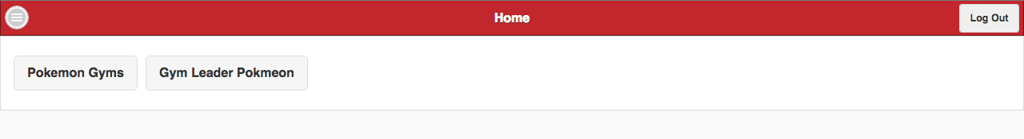
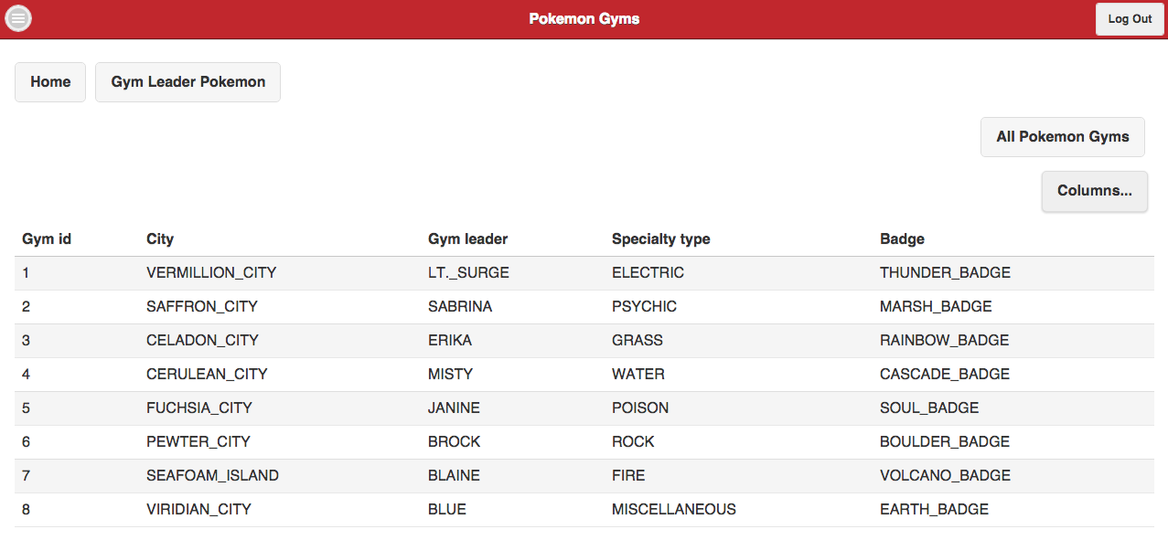
-> Main Page <-
-> Categories Table <-

Slide 22
THANK YOU

